Slide 1
Direct Deposit Training
A step-by-step guide to adding your direct deposit details into the
Global Employment Management System (GEMS)

Slide 2
Navigating to GEMS

Slide 3
Visit the USF website and login to MyUSF to access GEMS

Slide 4
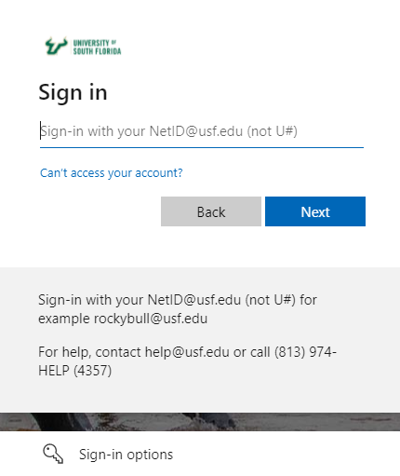
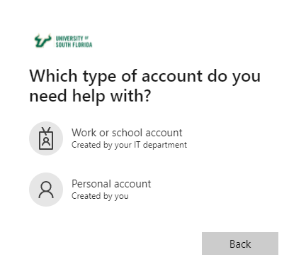
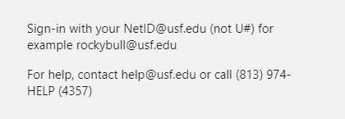
1
2
3
Login using your NetID@usf.edu to access GEMS (not U#) | Can’t access your account? Click this link for more guidance to access your account | If you have not established your NetID or need help, please reach out help@usf.edu or (813) 974-HELP (4357)

Slide 5
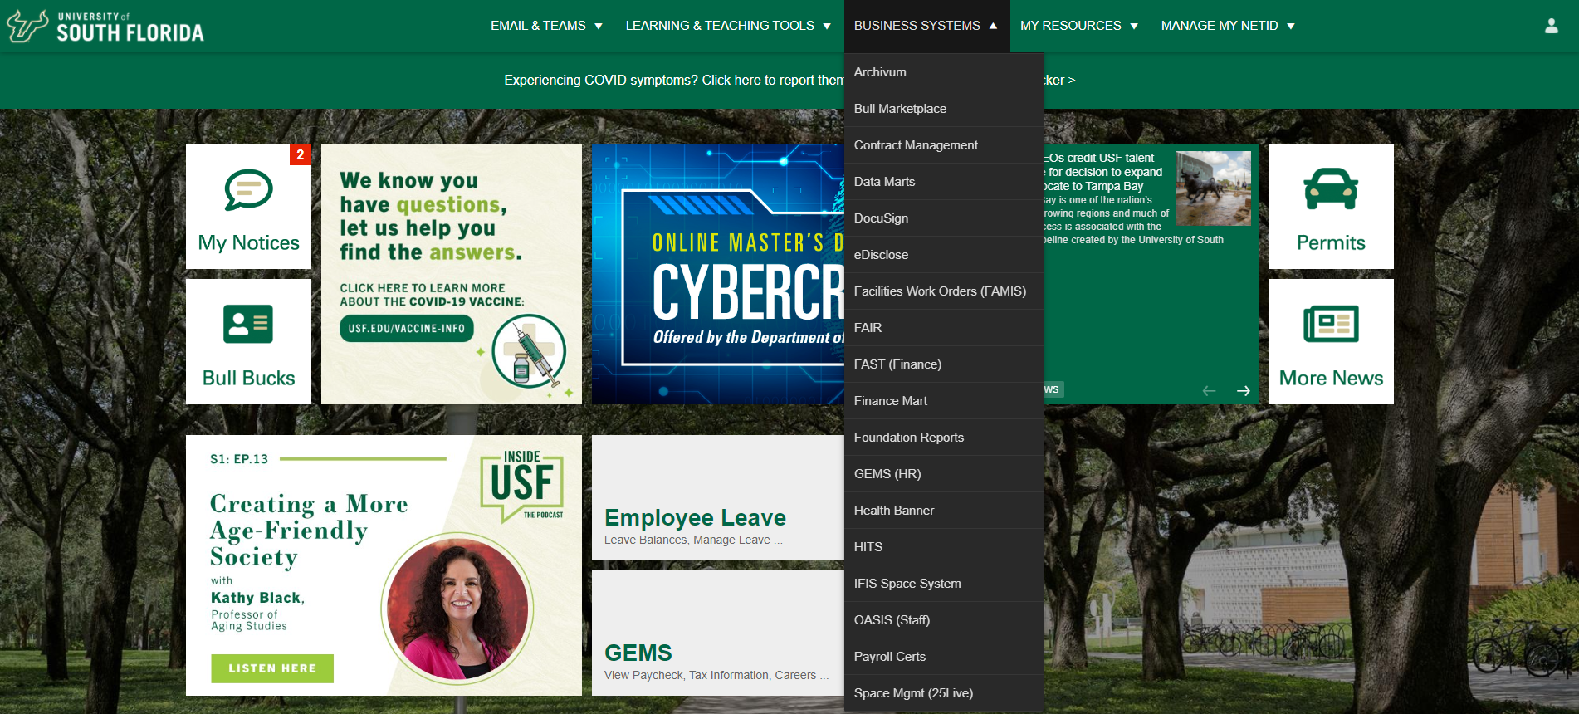
If you don’t see GEMS (HR) under Business Systems:
1
2
Have you begun employment at USF yet? The security will be activated on your start/hire date. | If you have started your employment and still cannot see GEMS under Business Systems – Contact help@usf.edu or dial (813) 974-4357

Slide 6
Select the Payroll tile in GEMS to access the Direct Deposit tool.

Slide 7
How to add your Direct Deposit Information

Slide 8
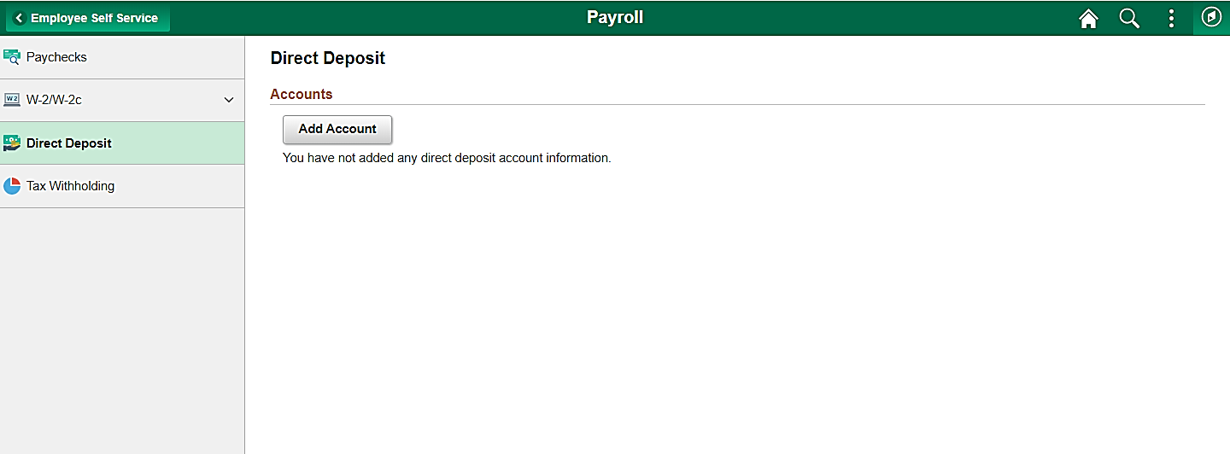
Start by selecting Direct Deposit in the left menu then, Add Account

Slide 9
Direct Deposit Entry
The Add Account page will pop up for all account details to be entered.
Nickname:
The nickname of the account being added can be the type of account you are setting up.
Example: Checking Account 1
Payment Method:
Direct Deposit is the only option.
Routing Number:
Enter in your bank’s routing number.
Help: If you are unsure what your banks routing number is, click the blue information button for an example.

Slide 10
This is an example of where the routing and account number is located on a check. Enter the values into the spots allotted.

Slide 11
Direct Deposit Entry
Add in Account Number information
Account Number:
Enter in your full bank account number.
Please see previous slide for an example if you are unsure where this information can be found.
Account Type:
Select the type of account you would like to set up
Deposit Type:
Select the type of deposit you would like to set up

Slide 12
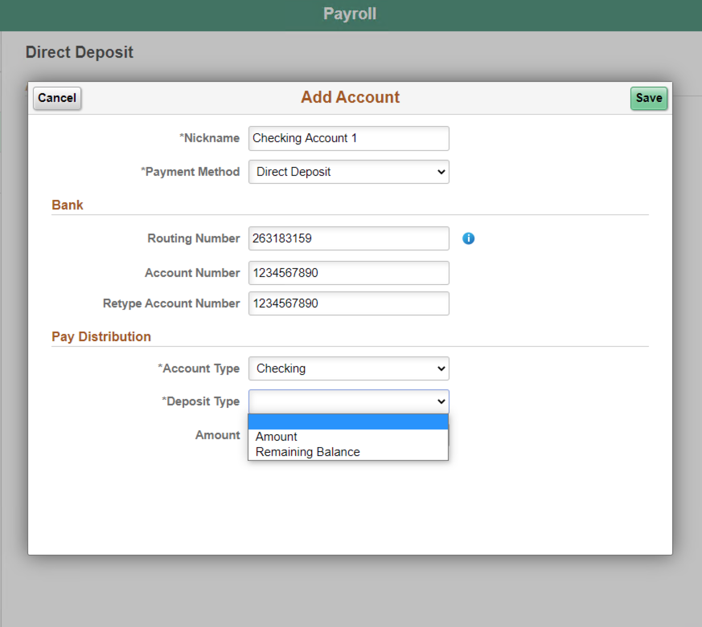
Account and Deposit Type Options
1
Account Type: Checking or Savings | Deposit Type: Amount or Remaining Balance
2

Slide 13
Direct Deposit Entry
Add in Deposit Type information
Deposit Type:
Amount:
Enter in a specific number that you would like direct deposited into the account information entered.
The amount entered will be subtracted from you total check amount.
Do not enter a dollar sign ($)

Slide 14
Direct Deposit Entry
Add in Deposit Type information
Deposit Type:
Remaining Balance
This option is used to deposit the remaining balance of your check into the account information entered.
If you want your whole check deposited into one account, use this option only.
Make sure to save after completing each account addition

Slide 15
To add another account, click the addition symbol (+)
Note: Employees must have one account as Remaining Balance. The other available accounts can be an Amount.
Percent values are not allowed.

Slide 16
Direct Deposit Entry
A saving account example
Savings Account:
This is an additional direct deposit entry. This example details a completed savings account as a specific amount that will be deposited.
Savings Account
Amount
200.00
Make sure to save any changes after completing

Slide 17
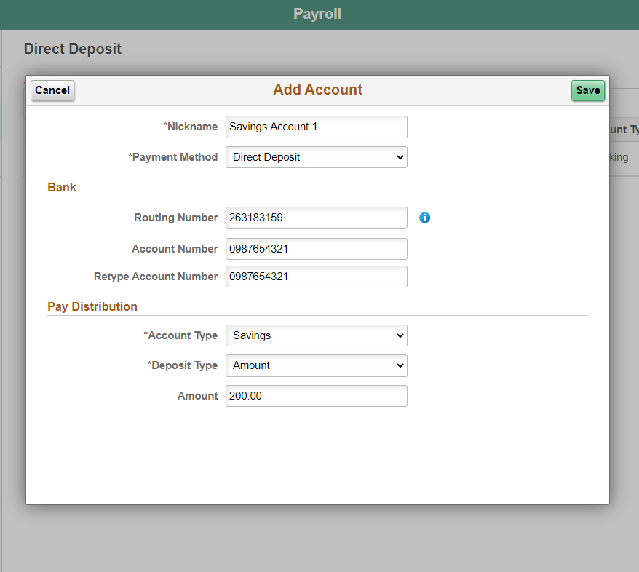
Direct Deposit Entry Examples
Deposit Type: Amount
Make sure to save after completing

Slide 18
To change how each entry is processed, select Reorder

Slide 19
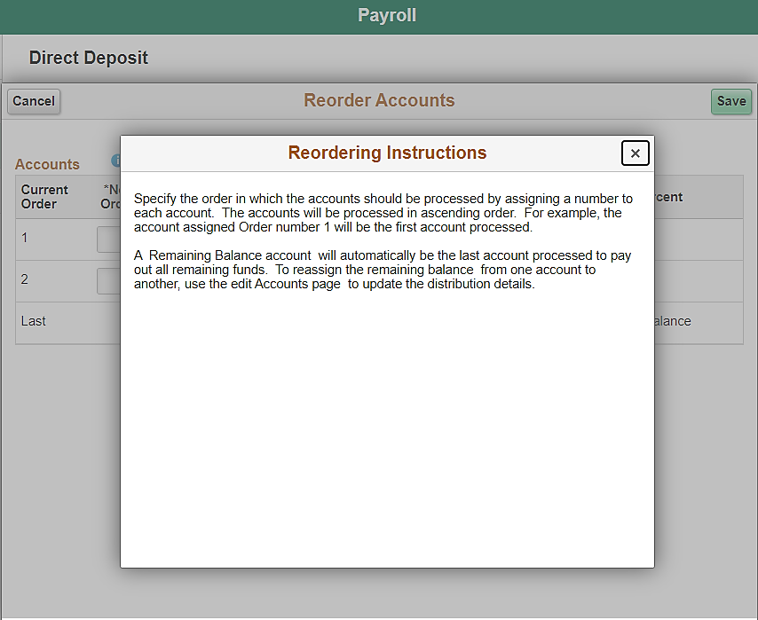
Account and Deposit Type Options

Slide 20
Completed Direct Deposit Entries
Note: If you enroll or make changes in the direct deposit tab, you cannot make any additional changes until the next day.

Slide 21
Helpful Tips
Employees must have one account as Remaining Balance. The other available accounts can be an Amounts. Percent values are not allowed.
If you enroll or make changes in the direct deposit tab, you cannot make any additional changes until the next day
Direct Deposit is inactivated after 120 days of being separated from the University.
Employees will no longer be able to view paystubs the next day after termination.
Payroll – About your Paystub

Slide 22
Thank you!
Learn more about the University of South Florida Payroll Department.
Contact for more information:
Payroll – ALN208
Payroll Help Desk (813) 974-7955

