Slide 1


Welcome To the
USF Financial System

Slide 2
USF System Overview
The University of South Florida is a large, public 4-year university offering undergraduate, graduate, specialist and doctoral level degrees. The USF System includes three, separately accredited institutions: USF; USF St. Petersburg; and USF Sarasota-Manatee. The USF System has an annual budget of nearly $1.8 billion.
USF includes the main campus in Tampa, the College of Marine Science in St. Petersburg, and USF Health.
The USF mission is to deliver competitive undergraduate, graduate, and professional programs, to generate knowledge, foster intellectual development, and ensure student success in a global environment.

Slide 3
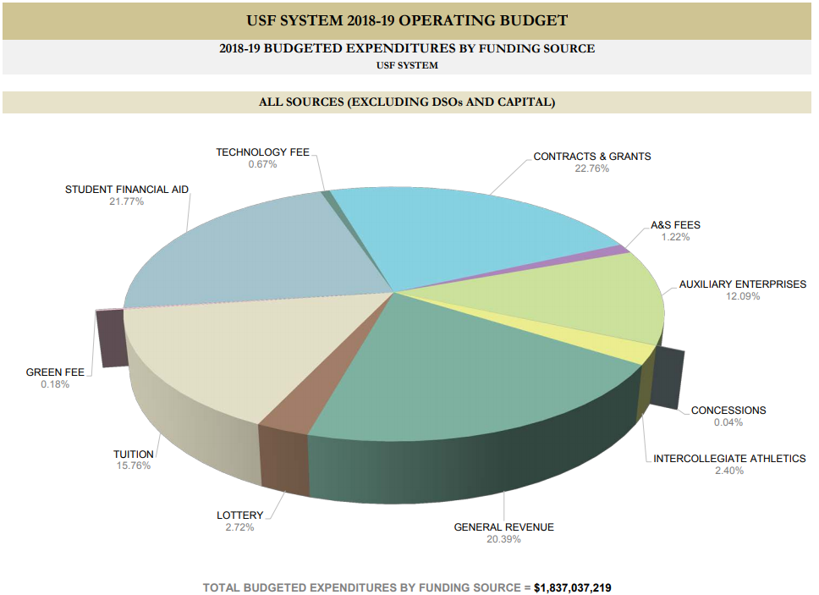
USF System Operating Budget

Slide 4
USF Governance
The USF System operates within the USF Board of Trustees governance structure
The USF BOT appoints the USF System President, who in turn appoints the Regional Chancellors of the member institutions
USF has many governance organizations that advise the President on matters of interest including the Administrative Advisory Council, the Faculty Senate, and the Staff Senate

Slide 5
Code of Conduct for Financial Functions
Supporting the constitution and laws of the State of Florida there is a USF Code of Conduct for Financial Functions. Find the document on the UCO web site under About UCO/Training and Resources/Business Training and also on the USF Business Processes web site.
There is also a separate statement of Fund Accountability and Signature Authorization supported by a Code of Ethics for the USF Foundation.

Slide 6
How is USF Similar to the Private World?
Similarities
  Need to control expenditures
  Need to be concerned about cash balances
  Need to adhere to accounting principles
  Are held accountable for our operations
  Are audited

Slide 7
How is USF Different From Private Business?
Private Business
  Emphasis on profit
  Company relies on sales and investments
  Responsible to shareholders
  Company may have subsidiaries
USF
  Emphasis on accountability
  USF relies on a variety of external funding sources
  Responsible to multiple organizations
    Board of Trustees
    State of Florida
    Research sponsors
  DSO, component units, auxiliaries, sponsored research

Slide 8
DSOs and Component Units
DSO - Direct Support Organizations
  Separate not-for-profit corporations
  Provide supplemental resources from private gifts and bequests and valuable educational support services
Component Units (CU)
  Any organization for which the nature and significance of their relationship to USF System is such that exclusion would cause the USF System financial statement to be misleading or incomplete

Slide 9
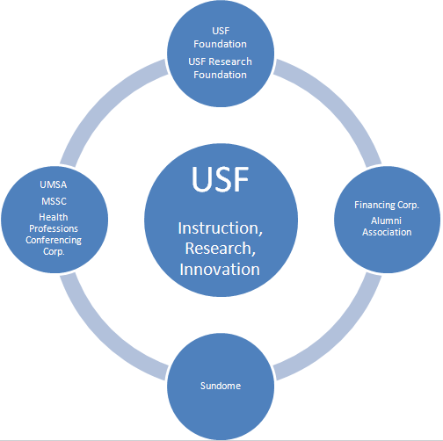
DSOs and Component Units

Slide 10
DSOs and Component Units
USF Foundation (DSO and CU)
The legal conduit for the raising, acceptance, investment, and distribution of all private gifts made to USF
USF Research Foundation (DSO and CU)
Supports technology research as a catalyst for economic development and advocates the development and construction of facilities for high technology companies and related support functions
Yuengling Center (formerly Sun Dome) (DSO and CU)
Organized to operate and administer certain facilities located on the campus

Slide 11
DSOs and Component Units
UMSA (DSO and CU)
University Medical Service Assn. operates exclusively for scientific and educational purposes
MSSC (DSO and CU)
Medical Services Support Corporation provides non-physician personnel and services in support of the operation of the facilities utilized by the University’s College of Medicine
HPCC (DSO and CU)
Committed to sponsoring quality activities/events to meet the needs of USF faculty

Slide 12
DSOs and Component Units
USF Financing Corporation (DSO and CU)
  The University's financing arm is expected to provide attractive long-term financing for the University's major capital projects.
USF Property Corporation (CU only)
  Organized to support the Finance Corporation by assisting in acquiring and constructing facilities
USF Alumni Association (DSO and CU)
  Seeks to maintain and enhance a mutually beneficial, lifelong relationship between the University and alumni
Find more information about DSOs view the USF Treasurer’s web site

Slide 13
Public Purpose Funds
State funding (E&G aka General Revenue)
  This is a budget allocation from the state of Florida
  E&G funds are supported by taxes, fees, and other state revenue
  It includes the “lottery” funds (Educational Enhancement Trust Fund)
  Not cash but spending authority allocated for one fiscal year
  May be carried over to a subsequent year (Carry-forward funds)
Auxiliary funds
  Generated by sales from authorized business activities
  Taxability concerns about relation to the USF mission
  Actual cash balances that roll forward year to year
  Requires EBA (Educational Business Activity) approval

Slide 14
Special Purpose Funds
Sponsored Research/Grant funding
  Federal, state, or private sources
  Allocated by a sponsoring agency to USF with a PI (project investigator) identified with a specific line item budget
RIA (Research Initiative funds)
  Includes F&A recovery, new faculty start-up funds, USF internal research awards, and residual amounts of fixed-price contracts
Student Fee Trust Fund
  Paid by students and used exclusively for student support
Local fees such as Tech fees and Green fees
  Fees charged to students to fund these specific programs

Slide 15
Not USF Money
Student Financial Aid
  May be received from federal, state, or private sources
  May involve a transfer from the USF Foundation
Agency funds
  For example sales tax collected from commercial sales of services to customers outside USF
Convenience funds
  Reimbursement received from a DSO or other organization (such as Moffitt) in acknowledgement of effort expended by USF staff in support of the USF College of Medicine clinics

Slide 16
Other Funding Sources
Other funding sources
  PECO
    Public Education Capital Outlay
    For building construction
  Bonding of buildings
    Our DSO, the Finance Corp.
  Concession Funds
    Revenue collected from vending machines and other coin operated campus services

Slide 17
Resource Management and Analysis
Resource Management and Analysis
  University Budgets & Reporting releases, manages, and reports budget activity
  RMA Web site
    http://www.usf.edu/business-finance/resource-management-analysis/ubr/index.aspx

Slide 18
Resource Management and Analysis
The web site provides guidance on:
  The operating budget
  The operating budget process
  A funding commitment training guide
  Budget transfer procedure
  Budget account mapping (linkage between budget codes and general ledger account codes for both expense and revenue)

Slide 19
How We Use the Budget Module
In FAST the Commitment Control module
  Expenses are budgeted for all funding sources
    Budget is reserved whenever a requisition or a purchase order is created
    Budget is consumed whenever a vendor invoice is paid
    Budget is consumed whenever a purchase is made with a USF P-card (procurement card)
  Budget is released to individual chart field strings
  Colleges and departments are accountable for their budgets

Slide 20
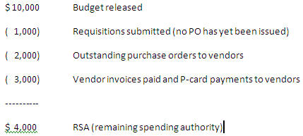
RSA – Your Available Budget
RSA – Residual Spending Authority

Slide 21
Commitment Control and Revenue
The module is also used to track revenue
  Auxiliaries have revenue targets for the fiscal year
  “Revenue Budget” is released to individual revenue chart field strings
  Periodically actual generated revenue is compared to the revenue budget
  It will not limit revenue

Slide 22
Primary Data Systems
Three primary financial data systems
  OASIS
    All student activity; financial and academic (Banner software)
  GEMS
    All human resource activity; financial and employment related
    PeopleSoft software
  FAST
    The actual financial accounting system for USF (PeopleSoft software)

Slide 23
Subsidiary Systems
Subsidiary systems
  TAS (IT telecommunications application)
  FACNET (Physical Plant management application)
Supporting and Reporting systems
  TouchNet (web based bank card payment processing)
  IFIS (space management application)
  BDMS (document imaging application)
  Data Warehouse (data collection from multiple applications)
  Finance Mart (the official financial reporting application)

Slide 24
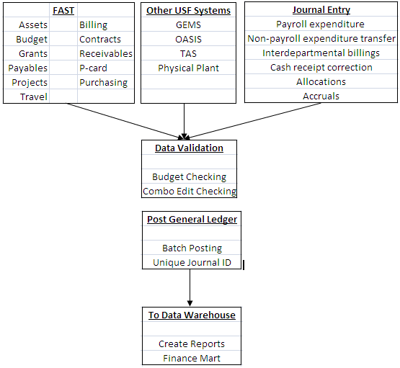
The Data Flow

Slide 25
Systems Require Security Roles
For FAST complete the security access form
  Find it on the UCO web site; www.usf.edu/business-finance/controller
  Email to FAST Security (appears as BUSFIN FAST Security in Outlook) for review

Slide 26
FAST Security is Role Based
You job duties drive what access you are granted
  We must avoid business conflicts; we must observe proper separation of duties
  Access is granted by specific roles with levels of access
    View only
    Add
    Update
  The request must be signed by your Accountable Officer

Slide 27
More Security Details
A few tips
  If you change jobs within USF
    On your last day in a position, your FAST ID will be automatically locked preventing use of the system
    Submit a FAST security update request to unlock your ID with new appropriate security roles
  If you leave USF employment
    On your last day, your FAST ID will be automatically locked
  Access to Finance Mart is open to all USF employees (you must have a USF employee ID); use your NetID to log in

Slide 28
Workflow
Notification system for two modules
  Purchasing workflow
  Travel workflow
Purchasing workflow assignments
  Send the form by email (Excel spreadsheet format)
  Controller’s office reviews and approves; IT updates workflow
Workflow is assigned based on chart fields

Slide 29
Workflow – Know Your Chart Fields
Hierarchy of chart fields for workflow
  Project ID
  Initiative
  Fund ID
  Operating Unit/Department ID combination
Choose carefully
  Don’t ask for assignments to general use chart fields
    Like Fund 10000 or the initiative DEPTMENT

Slide 30
Purchasing Workflow
Choose the correct role for assignment
  Accountable Officer
  Accountable Officer Designee
  Requisition Approver (needs USF_PO_REQAPPR security)
  Requisition Manager (needs USF_PO_REQAPPR security)
How to submit the request
  Email Excel spreadsheet to FAST Security (find in Outlook)

Slide 31
Travel Workflow
Anyone who participates in the travel process
  Needs FAST access
  Needs travel module workflow role assignment
How to submit the request
  Travel workflow is requested on page 3 of the FAST Access form
  Email the form to FAST Security (In Outlook)

Slide 32
Accountable Officers - Accountability?
Accountable officers are assigned to:
  A specific project ID
  A specific Initiative
  A specific fund code (usually an auxiliary fund)
  A specific combination of Operating Unit and Department
There can be only one accountable officer
  For a specific project, initiative, fund code, or combination of operating unit/department
  But every project, initiative, fund code, or operating unit/department must have an accountable officer

Slide 33
What Does The AO Do ?
Some of the primary fiduciary responsibilities
  Ensure purchases are made from valid, authorized funds
  Ensure that revenue is received and deposited timely
  Ensure that staff have the appropriate training necessary to create transactions in FAST
  Account for all USF equipment and assets
  Identify any fraudulent activity; notify authorities
  Review and approve system security requests and workflow requests

Slide 34
Online Business Processes
Our on-line guide to business process
  The address is www.usf.edu/businessprocesses
  Allows for keyword search or category search
  You may pose questions
  Look for information on
    Accounting practices
    HR-payroll
    Purchasing
    Research
    The USF Foundation
    And many other subject areas

Slide 35
Resources in University Controller’s Office
University Controller’s Office (UCO)
  The address is http://www.usf.edu/business-finance/controller
    Accounts Payable, Accounting Services, Asset Management, Payroll , Purchasing, Student Financial Services, Tax Advisory Services, Training and Travel
  A great glossary of research related activities and acronyms
  http://www3.research.usf.edu/dsr/desk-manual/glossary.asp#F

Slide 36
Help Is Available
aphelp@usf.edu accounts payable help
Asset-help@usf.edu asset management help
billingarhelp@usf.edu billing and AR help
cashiers@usf.edu cash office help
Electronic-media-disposal@usf.edu electronic media
financemart@usf.edu finance mart questions
payrollhelpdesk@usf.edu payroll questions
pcard@usf.edu Pcard questions
travelhelp@usf.edu travel questions
usfpurchasing@usf.edu purchasing help

Slide 37
More Resources
Join the FAST list serv
  Visit http://listserv.usf.edu/scripts/wa.exe?A0=FAST-LIST to subscribe; click Get Password
Join the Travel list serv
  Look on the travel home page to subscribe
Join the Payroll list serv
  Look on the Payroll Overview page to subscribe
Join the Purchasing list serv

Slide 38
Enough Already! On With The Show!

